Slide 1
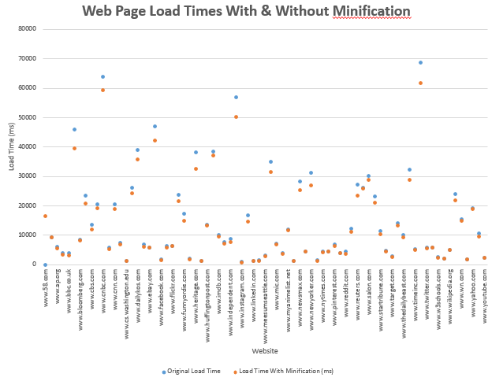
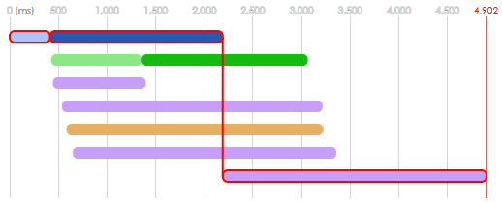
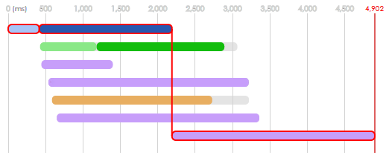
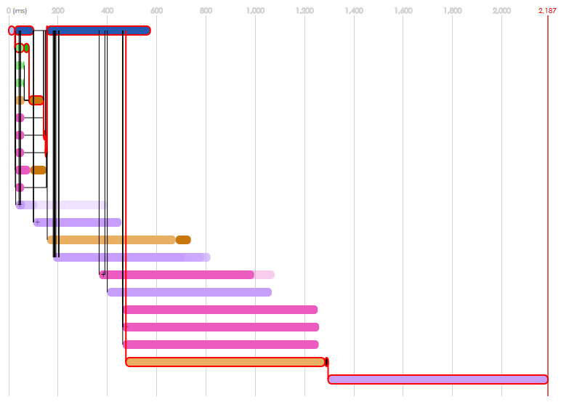
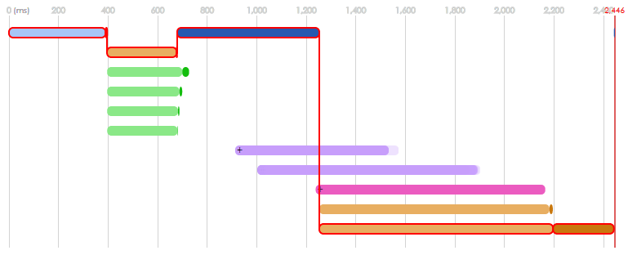
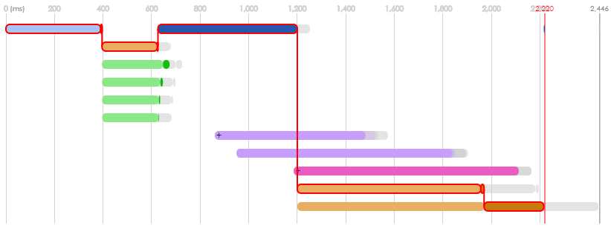
Optimizing Web Page Load Time
Objective
The long-term goal is to analyze the effects of different methods of optimizing page load time on different website and visualize it so that web developers can see which method would best reduce the page load time on their own website.
This poster focuses on analyzing and visualizing the effect of minification on page load time. Minification takes away spaces, enters, and tabs in the code in order to make files smaller.
Motivation
Faster pages help businesses as they attract customers.
Amazon revenue increased by 1% for every 0.1 second reduction in load time.
Shopzilla’s revenue increased by 12% by reducing loading time from 6 seconds to 1.2 seconds
Small and starting businesses in countries with slower Internet speed need a tool to determine the best method of speeding page load time the most.
Page loading time would be dramatically slower in areas with poor Internet connectivity or on slow devices, so fast web pages would be great advantages for a small business.
This software takes much less time than it would take to test out many different methods.
Page load time for washington.edu
In order to accurately determine the page load time without other variables like network speed, it is necessary to test the page load time in a more controlled system. The page load times for many different popular websites were gathered in a (find out how the load time info was gathered)
In order to test the page load time for minification, (find out how the minification time was done)
Results
Load time of youtube.com before minification
Load time of youtube.com after minification
Load time of wikipedia.com before minification
Load time of wikipedia.com after minification
In the majority of cases, the page load time after minification (in orange) is smaller than the page load time before (in blue). In some cases, the load time does not change at all.
Changes in time were not on the critical path.
The bars outlined in red are part of the critical path, which shows the path that takes the longest time. In order to shorten page load time, bars on the critical path must be shortened.
Because none of the bars on the critical path were shortened, the page load time did not decrease.
Conclusion
As seen in the data, minification cannot make a web page load slower.
Minification can only shorten JavaScript and CSS elements. If these elements are not on the critical path, the load time will not change.
Since minification is easy and can’t harm page load time, it is suggested that web developers always minify their websites.
Future Work
In the future, we’ll analyze more methods of optimizing page load time, such as compression.
The vertical black bars show dependencies, where one process must partially or completely finish before another can start.
Speed reductions on the critical path lead to faster overall speed.
Acknowledgements/References
The gray bars show the original speed before minification.

